Slide 1
IMMIGRANT
CITIZENS
SURVEY
How immigrants experience integration in 15 European cities

Slide 2
PARTNERS
Managing Partners
King Baudouin Foundation (KBF)
Migration Policy Group (MPG)
Co-funders:
European Commission
King Baudouin Foundation
Fundação Calouste
Gulbenkian Oak Foundation
Belgium
King Baudouin Foundation (KBF)
Université Libre de Bruxelles (ULB)
France
Fondation Nationale des Sciences Politiques (Science Po)
France Terre d’Asile
Germany
Research Unit of the Expert Council of German Foundations on Integration and Migration (SVR, Germany)
Hungary
MTAKI (MTA Etnikai-nemzeti Kisebbségkutató Intézet)
Menedék Hungarian Association for Migrants
Italy
Fondazione Ismu – Initiatives and Studies on Multiethnicity
Portugal
High Commission for Immigration and Intercultural Dialogue (ACIDI)
Spain
University of Leicester
Centro de Investigaciones Sociológicas
Fundacion CIDOB
Branding and Design:

Slide 3
CIVIC AND POLITICAL
PARTICIPATION
LONG - TERM RESIDENCE
EMPLOYMENT
FAMILY REUNION
LANGUAGES
CITIZENSHIP

Slide 4
FAMILY REUNION
How many people live in your household?
What’s your marital status? / What’s the nationality of your spouse?
Since you moved here, have you ever had a partner or child living outside the country?
Have you ever applied for family reunion? / When did you apply?
What happened to your application?
What problems did you have applying?
How has reuniting with your family helped you personally?
Would you like to apply for family reunion? Why not?
How might reuniting with your family help you personally?
HIGHLIGHTS

Slide 5
FAMILY REUNION
Key Findings
HAVE YOU REUNITED WITH YOUR PARTNER?
Today, most first-generation immigrants surveyed in the 15 cities do not currently need to reunite with a partner or children.

Slide 6
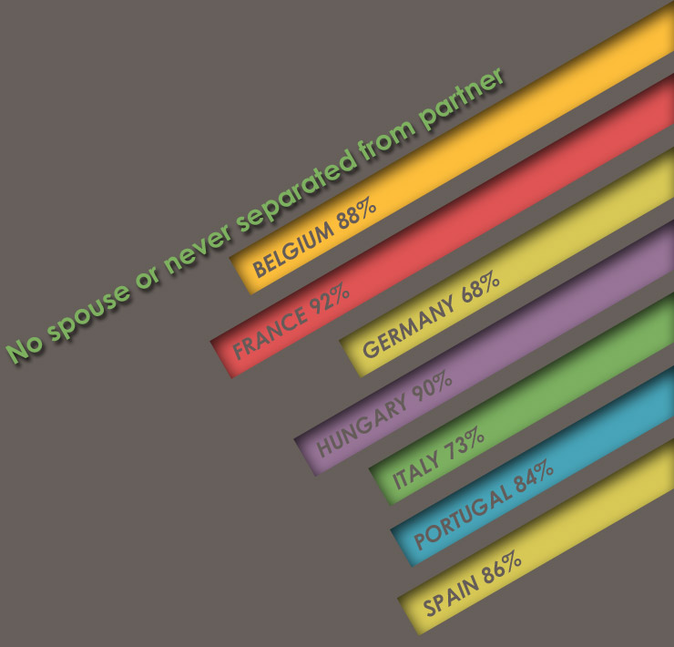
HAVE YOU REUNITED WITH YOUR PARTNER?
Only limited numbers of first-generation immigrants were ever separated from a partner or children

Slide 7
FAMILY REUNION
Key Findings
HAVE YOU REUNITED WITH YOUR CHILDREN?
The vast majority are either single, have always lived with their partner or children, or were the ones that reunited.
Whether these people will need family reunion in the future will depend on how their lives and families change over time.
Only a limited number of people who immigrated from outside the EU were or are separated from their families.

Slide 8
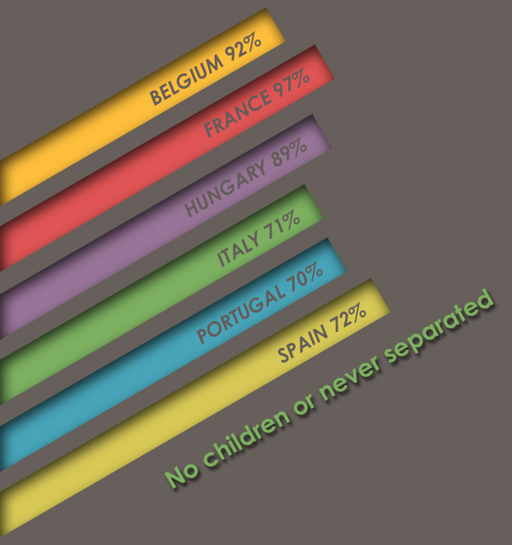
HAVE YOU REUNITED WITH YOUR CHILDREN?
The majority of separated families have already reunited in most surveyed countries.

Slide 9
FAMILY REUNION
Key Findings
WHY DO YOU NOT WANT TO REUNITE WITH YOUR PARTNER OR CHILDREN?
Most immigrants surveyed have their own reasons for not reuniting their family; several did not know or cited a specific reason.
Two major personal reasons were that some immigrants do not want to settle in the country or their family does not want to move. These family reasons were regularly given in Budapest and cities in Italy, Portugal, and, to a lesser extent, Belgium and Spain. But two other major reasons were related to policy.
Many separated immigrants do not know if they meet the family reunion requirements, particularly in cities in Belgium, Italy, and Portugal. Others say that they cannot meet the requirements, again in these cities as well as the two Spanish cities.

Slide 10
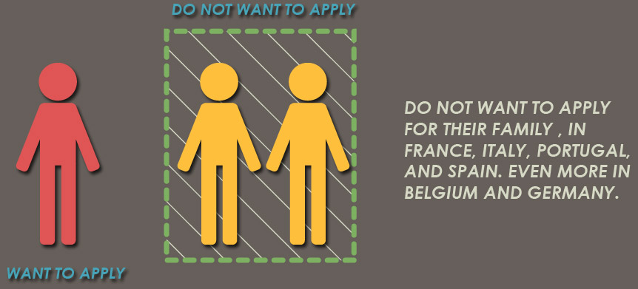
WHY DO YOU NOT WANT TO REUNITE WITH YOUR PARTNER OR CHILDREN?
Most separated immigrants today do not want to apply for their family, some because of family choices but others because of policy obstacles.

Slide 11
FAMILY REUNION
Key Findings
WHAT PROBLEMS DID YOU HAVE REUNITING WITH YOUR FAMILY?
Around half the immigrants who did apply for family reunion also cited problems with the family reunion procedure, specifically the requirements, documents, or discretion of the authorities.
Former applicants said that authorities had too much power to ‘do whatever they wanted’ during the procedure, particularly in French cities (38%), Italian cities (34%) and Portuguese cities (28%).
The documentation required was another important obstacle for family reunion in specific countries such as Belgium (24%) and Germany (50%). Applicants in German and Italian cities had the most problems, while applicants in Spanish cities reported the fewest.

Slide 12
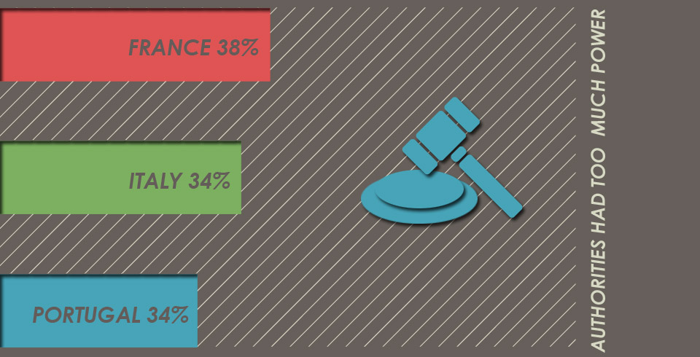
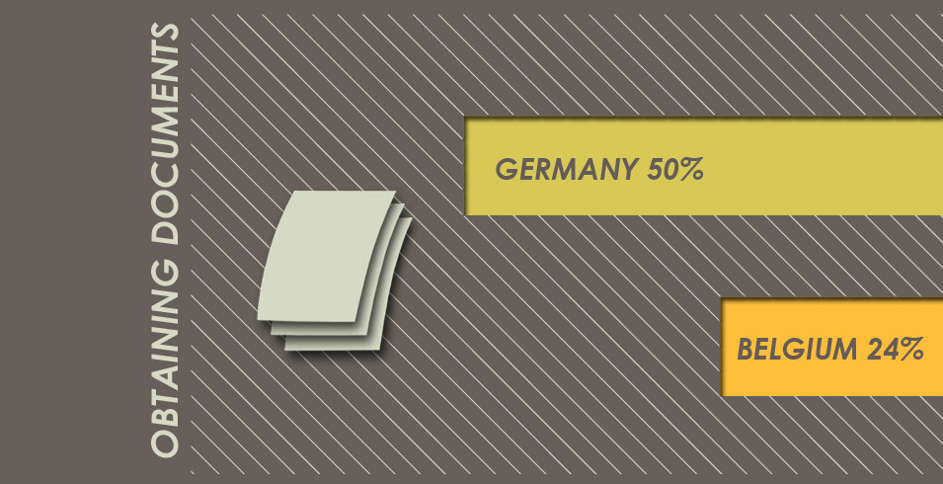
WHAT PROBLEMS DID YOU HAVE REUNITING WITH YOUR FAMILY?
Documents and powers of authorities cited as major problems for applicants in certain countries.

Slide 13
FAMILY REUNION
Key Findings
HOW HAS FAMILY REUNION HELPED YOU?
Successful sponsors perceived several positive effects of family reunion on their family life and social integration.
Nearly all enjoyed a much easier family life thanks to family reunion. Most felt more settled in the country.

Slide 14
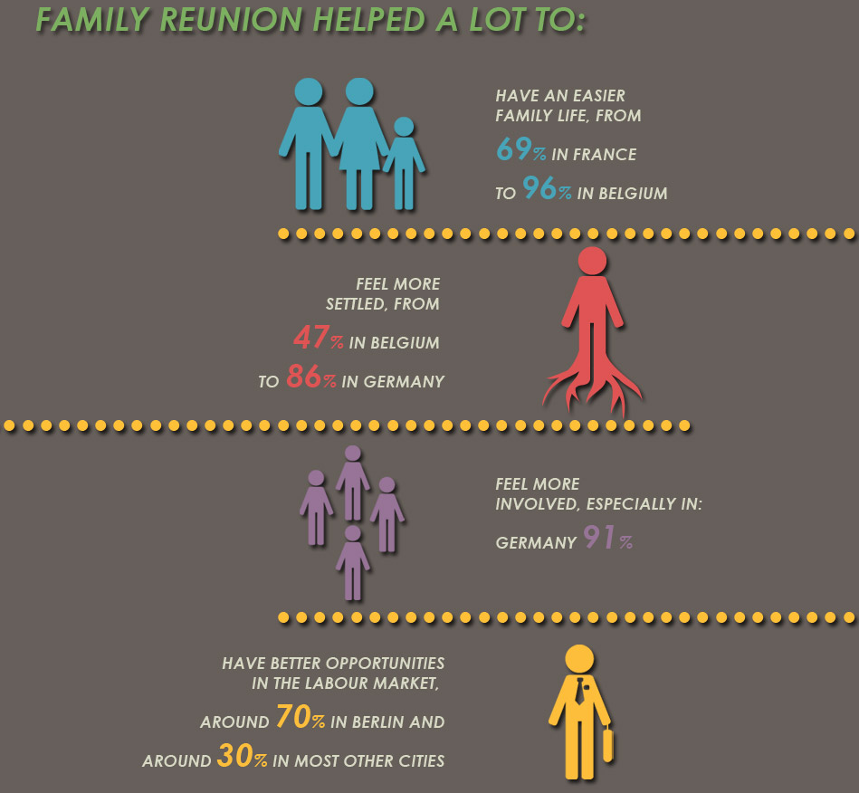
HOW HAS FAMILY REUNION HELPED YOU?
Family reunion helps immigrants improve family life, sense of belonging and sometimes other integration outcomes.

Slide 15
IMMIGRANT
CITIZENS
SURVEY
How immigrants experience integration in 15 European cities
Branding and Design:

